Slide 1
Hardware/Software Partitioning of Floating-Point Software Applications to Fixed-Point Coprocessor Circuits
Lance Saldanha, Roman Lysecky
Department of Electrical and Computer Engineering
University of Arizona
Tucson, AZ USA
{saldanha, rlysecky}@ece.arizona.edu

Slide 2
Introduction
Traditional HW/SW Partitioning
Software Application
(C/C++)
Benefits of HW/SW Partitioning
  Speedup of 2X to 10X
    Speedup of 1000X possible
  Energy reduction of 25% to 95%
HW/SW Partitioning Challenges
  Limited support for pointers
  Limited support for dynamic memory allocation
  Limited support for function recursion
  Very limited support for floating-point operations
Application Profiling
Critical Kernels
Partitioning
HW
SW
µP
I$
D$
HW COPROCESSOR (ASIC/FPGA)
Roman Lysecky, University of Arizona

Slide 3

Introduction
Floating Point Software Applications
Floating Point Representation
Pros
  IEEE standard 754
  Convenience - supported within most programming languages
    C, C++, Java, etc.
Cons
  Partitioning floating point kernels directly to hardware requires:
    Large area resources
    Multi-cycle latencies
Alternatively, can use fixed point representation to support real numbers
void Reference_IDCT(short* block) {
int i, j, k, v;
float part_prod, tmp[64];
for (i=0; i<8; i++)
for (j=0; j<8; j++) {
part_prod = 0.0;
for (k=0; k<8; k++) {
part_prod+=c[k][j]*block[8*i+k];
}
tmp[8*i+j] = part_prod;
}
...
}
Single Precision Floating Point:
S | E (8 bits) | M (23 bits)
Roman Lysecky, University of Arizona

Slide 4

Introduction
Fixed Point Software Applications
Fixed Point Representation
Pros
  Simple and fast hardware implementation
    Mostly equivalent to integer operations
Cons
  No direct support within most programming languages
Requires application to be converted to fixed point representation
void Reference_IDCT(short* block) {
int i, j, k, v;
float part_prod, tmp[64];
for (i=0; i<8; i++)
for (j=0; j<8; j++) {
part_prod = 0.0;
for (k=0; k<8; k++) {
part_prod+=c[k][j]*block[8*i+k];
}
tmp[8*i+j] = part_prod;
}
...
}
typedef long fixed;
#define PRECISION_AMOUNT 16
void Reference_IDCT(short* block) {
int i, j, k, v;
fixed part_prod, tmp[64];
long long prod;
for (i=0; i<8; i++)
for (j=0; j<8; j++) {
part_product = 0;
for (k=0; k<8; k++) {
prod=c[k][j]*( ((fixed)block[8*i+k])
<<PRECISION_AMOUNT );
part_prod += prod >>(PRECISION_AMOUNT*2));
}
tmp[8*i+j] = part_prod;
}
...
}
Fixed Point (32.20):
I (12 bits) | F (20 bits)
Roman Lysecky, University of Arizona

Slide 5
Introduction
Converting Floating Point to Fixed Point
Converting Floating Point SW to Fixed Point SW
  Manually or automatically convert software to utilize fixed point representation
Need to determine appropriate fixed point representation
Software Application
(Float)
Float to Fixed Conversion
Software Application
(C/C++)
Software Application
(Fixed)
Application Profiling
Critical Kernels
Partitioning
HW
SW
Roman Lysecky, University of Arizona

Slide 6
Introduction
Converting Floating Point to Fixed Point
Automated Tools for Converting Floating Point to Fixed Point
  fixify - Belanovic, Rupp [RSP 2005]
    Statistical optimization approach to minimize signal to quantization noise (SQNR) of fixed point code
  FRIDGE - Keding et al. [DATE 1998]
    Designer specified annotations on key fixed point values can be interpolated to remaing code
  Cmar et al. [DATE 1999]
    Annotate fixed point values with range requirements
    Iterative designer guided simulation framework to optimize implementation
  Menard et al. [CASES 2002], Kum et al. [ICASSP 1999]
    Conversion for fixed-point DSP processors
Software Application
(Float)
Float to Fixed Conversion
Software Application
(C/C++)
Software Application
(Fixed)
Application Profiling
Critical Kernels
Partitioning
HW
SW
Roman Lysecky, University of Arizona

Slide 7
Introduction
Converting Floating Point to Fixed Point
Converting Floating Point SW to Fixed Point HW
  Convert resulting floating point hardware to fixed point software to utilize fixed point representation
  Shi, Brodersen [DAC 2004]
  Cmar et al. [DATE 1999]
Must still convert software to fixed point representation
Software Application
(C/C++)
Application Profiling
Critical Kernels
(Float)
Partitioning
SW (C/Matlab)
SW
(Float)
HW
Float to Fixed Conversion
HW
(Fixed)
SW
(Fixed)
Roman Lysecky, University of Arizona

Slide 8
Partitioning Floating Point SW to Fixed Point HW
Separate Floating Point and Fixed Point Domains
Proposed Partitioning for Floating Point SW to Fixed Point HW
  Separate computation into floating point and fixed point domains
  Floating Point Domain
    Processor (SW), Caches, and Memory
    All values in memory will utilize floating point representation
  Fixed Point Domain
    HW Coprocessors
    Float-to-Fixed and Fixed-to-Float converters at boundary between SW/Memory and HW will perform conversion
FLOATING POINT DOMAIN
µP
I$
D$
Fixed-to-Float
Float-to-Fixed
HW COPROCESSORS (ASIC/FPGA)
FIXED POINT DOMAIN
Roman Lysecky, University of Arizona

Slide 9
Partitioning Floating Point SW to Fixed Point HW
Separate Floating Point and Fixed Point Domains
Potential Benefits
  No need to re-write initial floating point software
    Final software can utilize floating point
  Efficient fixed point implementation
  Can treat floating point values as integers during partitioning
Still requires determining the appropriate fixed point representation
  Can be accomplished using existing methods or directly specified by designer
Software Application
(C/C++)
Application Profiling
Critical Kernels
Partitioning
Floating Point Profiling (Optional)
HW
(Integer)
Fixed Point Representation
Fixed Point Conversion
HW
(Fixed)
SW
(Float)
Roman Lysecky, University of Arizona

Slide 10
Partitioning Floating Point SW to Fixed Point HW
Float-to-Fixed and Fixed-to-Float Converters
Float
RadixPoint
Float-to-Fixed and Fixed-to-Float Converters
  Implemented as configurable Verilog modules
  Configurable Floating Point Options:
    FloatSize
    MantissaBits
    ExponentBits
  Configurable Fixed Point Options:
    FixedSize
    RadixPointSize
    RadixPoint
  RadixPoint can be implemented as input or parameter
FloatSize
RadixPointSize
NormalCases
Normal
S
E
Normal Cases
Special Cases
M
Zero
Shift Calc
Dir
Shifter
Amount
-
Overflow
Calc
FixedSize
Exception
Overflow
Fixed
Roman Lysecky, University of Arizona

Slide 11
Partitioning Floating Point SW to Fixed Point HW
Coprocessor Interface
Hardware Coprocessor Interface
  Integrates Float-to-Fixed and Fixed-to-Float converters with memory interface
  All values read from memory are converted through Float-to-Fixed converter
    Integer: IntDataIn
    Fixed: FixedDataIn
  Separate outputs for integer and fixed data
    Integer: WrInt, IntDataOut
    Fixed: WrFixed, FixedDataOut
Addr
BE
Rd
Wr
DataOut
DataIn
Fixed-to-Float
Float-to-Fixed
WrInt
FixedDataOut
FixedDataIn
WrFixed
IntDataIn
IntDataOut
HW Coprocessor
Roman Lysecky, University of Arizona

Slide 12
Partitioning Floating Point SW to Fixed Point HW
Partitioning Tool Flow
HW/SW Partitioning of Floating Point SW to Fixed Point HW
  Kernels initially partitioned as integer implementation
  Synthesis annotations used to identify floating point values
Software Application
(C/C++)
Application Profiling
Critical Kernels
Partitioning
module Coprocessor (Clk, Rst, Addr, BE, Rd, Wr, DataOut, DataIn); input Clk, Rst; output [31:0] Addr; output BE, Rd, Wr; output signed [31:0] DataOut; input signed [31:0] DataIn; // syn_fixed_point (p:SP) reg signed [31:0] p; reg signed [31:0] c1; always @(posedge Clk) begin // syn_fixed_point (p:SP, DataIn:SP) p <= p * DataIn + c1; end endmodule
Floating Point Profiling (Optional)
HW
(Integer)
Fixed Point Representation
Fixed Point Conversion
HW
(Fixed)
SW
(Float)
Roman Lysecky, University of Arizona

Slide 13
Partitioning Floating Point SW to Fixed Point HW
Partitioning Tool Flow
HW/SW Partitioning of Floating Point SW to Fixed Point HW
  Fixed point registers, computations, and memory accesses converted to specified representation
Software Application
(C/C++)
Application Profiling
Critical Kernels
Partitioning
module Coprocessor (Clk, Rst, Addr, BE, Rd, Wr, DataOut, DataIn); input Clk, Rst; output [31:0] Addr; output BE, Rd, Wr; output signed [31:0] DataOut; input signed [31:0] DataIn; // syn_fixed_point (p:SP) reg signed [31:0] p; reg signed [31:0] c1; always @(posedge Clk) begin // syn_fixed_point (p:SP, DataIn:SP) p <= p * DataIn + c1; end endmodule
module Coprocessor (Clk, Rst, Addr, BE, Rd, WrInt, WrFixed, IntDataOut, FixedDataOut, IntDataIn, FixedDataIn); ... // Fixed point register reg signed [FixedSize-1:0] p; // Integer register reg signed [31:0] c1; always @(posedge Clk) begin // Fixed point multiplication and addition // with conversion from integer to fixed // point p <= ((p * FixedDataIn) >>> RadixPoint) + (c1 << RadixPoint); end endmodule
Floating Point Profiling (Optional)
HW
(Integer)
Fixed Point Representation
Fixed Point Conversion
HW
(Fixed)
SW
(Float)
Roman Lysecky, University of Arizona

Slide 14
Partitioning Floating Point SW to Fixed Point HW
Experimental Results
Experimental Setup
  250 MHz MIPS processor with floating point support
  Xilinx Virtex-5 FPGA
    HW coprocessors execute at maximum frequency achieved by Xilinx ISE 9.2
Benchmarks
  MPEG2 Encode/Decode (MediaBench)
  Epic (MediaBench)
  FFT/IFFT (MiBench)
  All applications require significant floating point operations
  Partition both integer and floating point kernels
FLOATING POINT DOMAIN
µP
I$
D$
Fixed-to-Float
Float-to-Fixed
HW COPROCESSORS (ASIC/FPGA)
FIXED POINT DOMAIN
Roman Lysecky, University of Arizona

Slide 15
Partitioning Floating Point SW to Fixed Point HW
Experimental Results
Floating Point and Fixed Point Representations
  Utilized fixed point representation that provide identical results as software floating point implementation
  MPEG2 Encode/Decode (MediaBench)
    Float: integer (memory), single precision (computation)
    Fixed: 32-bit, radix of 20 (12.20)
  Epic (MediaBench)
    Float: single precision (memory), double precision (computation)
    Fixed: 64-bit, radix of 47 (17.47)
  FFT/IFFT (MiBench)
    Float: single precision (memory), double precision (computation)
    Fixed: 51-bit, radix of 30 (21.30)
FLOATING POINT DOMAIN
µP
I$
D$
Fixed-to-Float
Float-to-Fixed
HW COPROCESSORS (ASIC/FPGA)
FIXED POINT DOMAIN
Roman Lysecky, University of Arizona

Slide 16
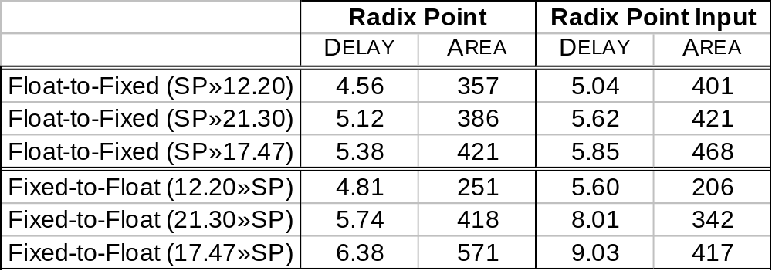
Partitioning Floating Point SW to Fixed Point HW
Experimental Results – Float-to-Fixed and Fixed-to-Float Converters
Fixed-to-Float and Float-to-Fixed Converter Performance (RadixPoint Parameter vs. Input)
  Float-to-Fixed (RadixPoint Parameter):
    9% faster and 10% fewer LUTs compared to input version
  Fixed-to-Float (RadixPoint Parameter):
    25% faster but requires 30% more LUTs than input version
FLOATING POINT DOMAIN
µP
I$
D$
Fixed-to-Float
Float-to-Fixed
HW COPROCESSORS (ASIC/FPGA)
FIXED POINT DOMAIN
Roman Lysecky, University of Arizona

Slide 17
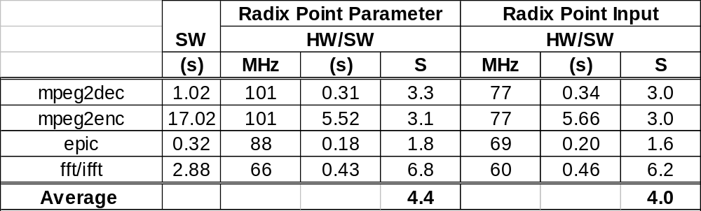
Partitioning Floating Point SW to Fixed Point HW
Experimental Results – Application Speedup
Application Speedup
  RadixPoint Parameter Implementation:
    Average speedup of 4.4X
      Maximum speedup of 6.8X (fft/ifft)
  RadixPoint Input Implementation:
    Average speedup of 4.0X
      Maximum speedup of 6.2X (fft/ifft)
FLOATING POINT DOMAIN
µP
I$
D$
Fixed-to-Float
Float-to-Fixed
HW COPROCESSORS (ASIC/FPGA)
FIXED POINT DOMAIN
Roman Lysecky, University of Arizona

Slide 18
Conclusions
Conclusions
  Presented a new partitioning approach for floating point software applications
    No need to re-write initial floating point software
    Hardware coprocessors utilize efficient fixed point implementation
    Can treat floating point values as integers during partitioning
  Developed efficient, configurable Float-to-Fixed and Fixed-to-Float hardware converters
    Implemented in Verilog with both parameter and input options for specifying RadixPoint
  Developed semi-automated HW/SW partitioning approach for floating point applications
    Achieves average application speedup of 4.4X (max of 6.8X) compared to floating point software implementation
    HW coprocessor area requirements similar to integer based coprocessor implementation
Roman Lysecky, University of Arizona

Slide 19
Current and Future Work
Current Work
  Dynamically adaptable fixed-point coprocessors
    Float-to-Fixed and Fixed-to-Float converters opens door to dynamically adapting fixed point representation at runtime
    RadixGen Component
      Responds to various overflows and dynamically adjusts RadixPoint
        Float-to-Fixed conversion overflow
        Integer-to-Fixed conversion overflow
        Arithmetic overflow
  Initial results achieve similar performance speedups compared to RadixPoint input implementation
FLOATING POINT DOMAIN
FLOATING POINT DOMAIN
µP
I$
µP
I$
D$
D$
Fixed-to-Float
Float-to-Fixed
Fixed-to-Float
Float-to-Fixed
Coprocessor
RadixGen
HW COPROCESSORS (ASIC/FPGA)
Conv.
FIXED POINT DOMAIN
Integer
Arithmetic
FIXED POINT DOMAIN
Roman Lysecky, University of Arizona

Slide 20
Current and Future Work
Future Work
  Optimization of fixed point coprocessor implementation
    Utilize multiple fixed point representation within single computation
    Reduce area, improve performance, or reduce power?
  Integrating proposed methodology with existing high-level synthesis tools
  Further developing dynamically adaptable fixed-point representation
    Can dynamically adaptable fixed point representation provide same dynamic range and precision of floating point implementation?
Code Release
  Release of Verilog for Fixed-to-Float and Float-to-Fixed components in near future
  http://www.ece.arizona.edu/~embedded
Roman Lysecky, University of Arizona

